Slide 1
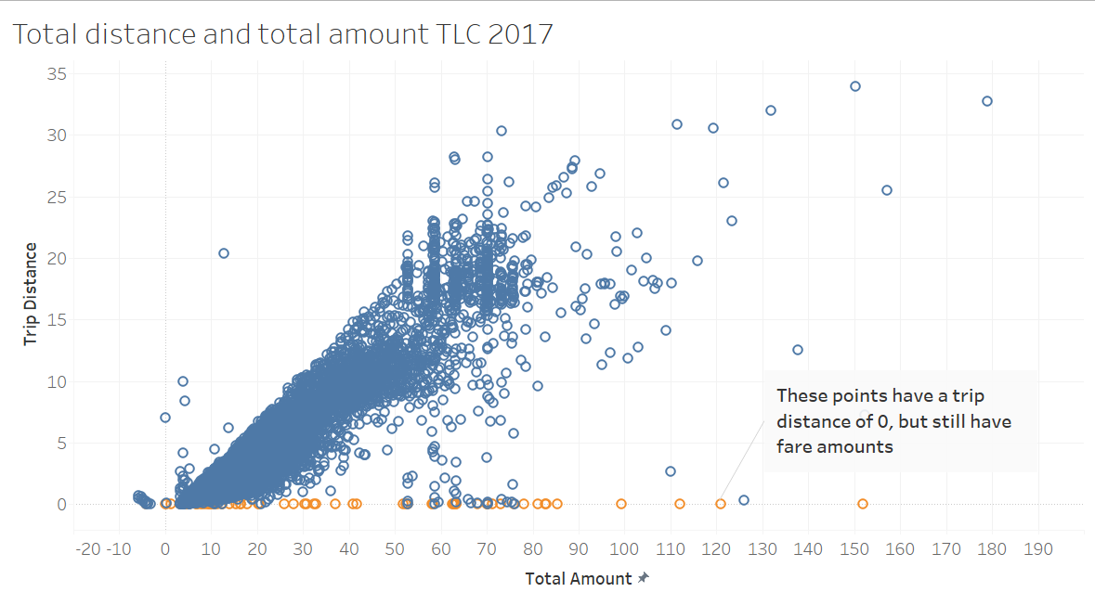
New York City TLC Project EDA Summary
Executive Summary Report
Project Overview
The New York City Taxi and Limousine Commission (TLC) contracted Automatidata to develop a regression model that helps estimate taxi fares before the ride. The Automatidata data team performed an exploratory data analysis.
Problem:
After initial EDA, it is clear that some data have problem that can affect our trip fares prediction accuracy.
There are some data with trip distance of 0, but still have fare amounts
Proposed solution:
We recommend to remove outliers with trip distance of 0.
Important key factors:
Ensuring the data sample is accurately representing the data as a whole.
Plan to remove other outliers in the data
Determine if some unusual data could pose a future problem for future analysis in predicting trip fares
Determine which variables have the biggest impact on trip fares
Choose the most relevant variables for running regression, statistical analysis, and parameter tuning

